Slide 1
MINI PROJECT PRESENTATION
ADITHYA BATHINENI
ANEERAJ BIDLAN
JOHN PAUL
KUBERA SANTHOSH VENKATESWARA GUPTA
RAMA TULASI ACHANTA

Slide 2
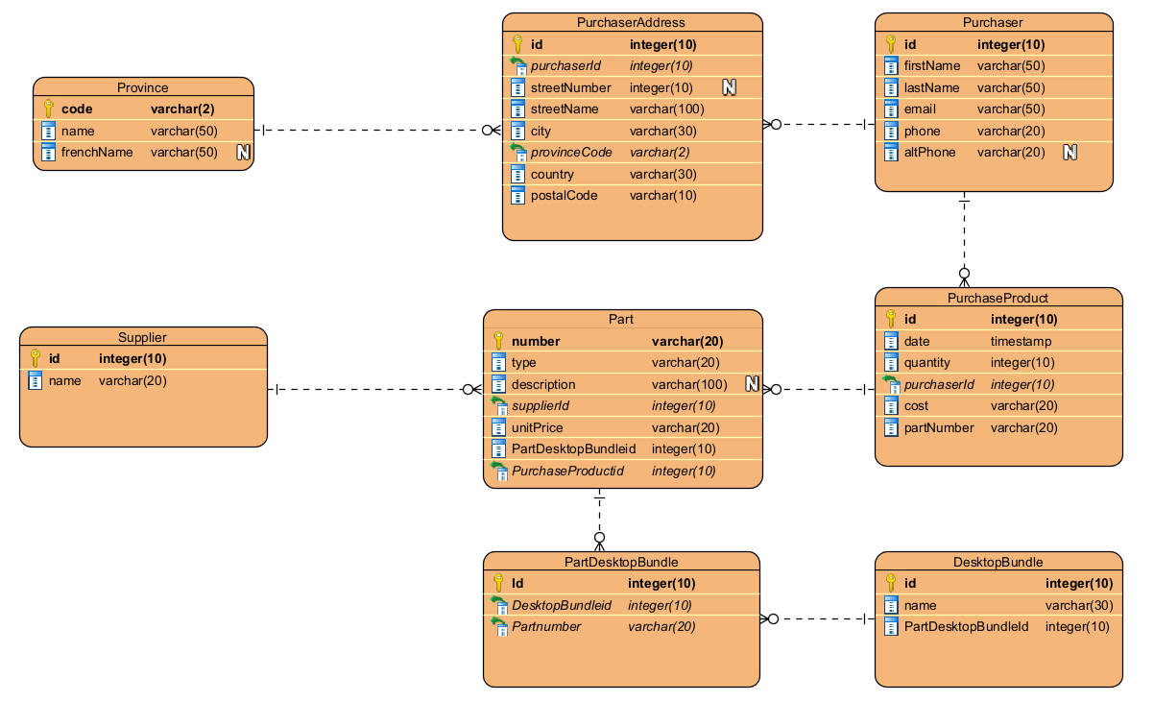
ER DIAGRAM

Slide 3
Breakdown of Tables - Cardinality
Province – PurchaserAddress (1-M)
PurchaserAddress – Purchaser (M-1)
Supplier – Part (1-M)
Purchaser – PurchaseProduct (1-M)
Part – PurchaseProduct (M-1)
Part – PartDesktopBundle – DesktopBundle (1-M-M-1)

Slide 4
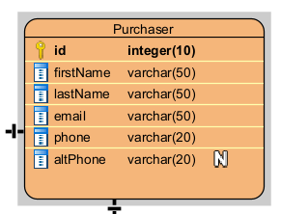
Table Structure
Purchaser Table:
id INT PRIMARY KEY,
"firstName" NVARCHAR(50) NOT NULL
CONSTRAINT CK_Purchaser_firstName
CHECK(LEN(firstName) >= 3),
"lastName" NVARCHAR(50),
"email" NVARCHAR(50) NOT NULL,
phone NVARCHAR(20) NOT NULL,
altPhone NVARCHAR(20),

Slide 5
Table Structure(Contd.)
DATA INSERT WITH COLUMN NAMES:
INSERT INTO Purchaser (id, firstName, lastName, email, phone) VALUES(1, 'Joey', 'Doe', 'john.doe@email.com','5876752009');
INSERT INTO Purchaser (id, firstName, lastName, email, phone) VALUES(2, 'May', 'Smith', 'may.smith@email.com','5876952009');
INSERT INTO Purchaser (id, firstName, lastName, email, phone) VALUES(3, 'Vinh', 'Gallagher', 'vinh.gallagher@email.com','5876755644');
INSERT INTO Purchaser (id, firstName, lastName, email, phone) VALUES(4, 'Troy', 'Allen', 'troy.allen@email.com','5874566390');

Slide 6
Constraints: Breakdown
PRIMARY KEY(PK):
id INT PRIMARY KEY <- PURCHASER TABLE
id INT IDENTITY PRIMARY KEY <- PURCHASEPRODUCT TABLE
id int IDENTITY(1001,1) PRIMARY KEY <- SUPPLIER TABLE
CHECK(CK):
"firstName" NVARCHAR(50) NOT NULL
CONSTRAINT CK_Purchaser_firstName CHECK(LEN(firstName) >= 3) <- PURCHASER TABLE

Slide 7
Constraints: Breakdown (Contd.)
DEFAULT(DF):
country NVARCHAR(30)
CONSTRAINT Country_DF
DEFAULT 'CANADA’, <- PURCHASERADDRESS TABLE
FOREIGN KEY(FK):
provinceCode NCHAR(2) NOT NULL
FOREIGN KEY (ProvinceCode) <- FOREIGN KEY IN PURCHASER TABLE
REFERENCES Province(code), <- PRIMARY KEY OF PROVINCE TABLE

Slide 8
SWC_XX Constraints
Table Name | Constraint Name
Province | PK__Province__357D4CF85EBA786B
Purchaser | PK__Purchase__3213E83FEBB89ED0
Purchaser | CK_Purchaser_firstName
PurchaserAddress | PK__Purchase__3213E83FE7A20BD6
PurchaserAddress | FK__Purchaser__purch__3C69FB99
PurchaserAddress | FK__Purchaser__provi__3E52440B
Supplier | PK__Supplier__3213E83FCD2848C8
DesktopBundle | PK__DesktopB__3213E83FA2DA6329
Part | PK__Part__FD291E40A9D71157
Part | CK_part_description_length
Part | CK_part_unit_price_positive
Part | FK__Part__supplierId__46E78A0C
PurchaseProduct | PK__Purchase__3213E83FFBC24C8F
PurchaseProduct | CK_PurchaseProduct_quantity_positive
PurchaseProduct | FK__PurchaseP__purch__4AB81AF0
PurchaseProduct | FK__PurchaseP__partn__4BAC3F29
PurchaseProduct | FK__PurchaseP__suppl__4CA06362
Part_DesktopBundle | PK__Part_Des__3213E83F7257403A
Part_DesktopBundle | FK__Part_Desk__partN__5070F446
Part_DesktopBundle | FK__Part_Desk__deskt__5165187F

Slide 9
INDEXES
UNIQUE INDEX FOR PURCHASER EMAIL:
DROP INDEX IF EXISTS idx_emailId ON Purchaser;
CREATE UNIQUE INDEX idx_emailId ON Purchaser(email);
INSERT INTO Purchaser (id, firstName, lastName, email, phone, altPhone)
VALUES (5, 'John', 'Paul', 'AB@example.com', '1234567890', '57487878567');
INSERT INTO Purchaser (id, firstName, lastName, email, phone, altPhone)
VALUES (6, 'Adithya', 'Bathineni', 'AB@example.com', '1234567891', '5748690373’);
Cannot insert duplicate key row in object 'dbo.Purchaser' with unique index 'idx_emailId'. The duplicate key value is (AB@example.com).
The statement has been terminated.

Slide 10
INDEXES (Contd.)
INDEX FOR PHONE NUMBER:
DROP INDEX IF EXISTS idx_phoneNumber ON Purchaser;
CREATE INDEX idx_phoneNumber ON Purchaser(phone);

Slide 11
VIEWS
VIEW TO CALCULATE EXTENDED AMOUNT OF PURCHASES:
DROP VIEW IF EXISTS VW_PurchaseDetailsWithExtendedAmount;
GO
CREATE VIEW VW_PurchaseDetailsWithExtendedAmount AS
SELECT
PurchaseProduct.date AS PurchaseDate,
Purchaser.firstName AS PurchaserFirstName,
Purchaser.lastName AS PurchaserLastName,
Supplier.name AS SupplierName,
Part.number AS PartNumber,
Part.description AS PartDescription,
PurchaseProduct.quantity AS Quantity,
Part.unitPrice AS UnitPrice,
Quantity * UnitPrice AS ExtendedAmount FROM PurchaseProduct
JOIN Purchaser ON PurchaseProduct.purchaserId = Purchaser.id
JOIN Part ON PurchaseProduct.partNumber = Part.number
JOIN Supplier ON PurchaseProduct.supplierId = Supplier.id;

Slide 12
VIEWS (Contd.)
PurchaseDate | Purchaser FirstName | Purchaser LastName | Supplier Name | PartNumber | PartDescription | Quantity | UnitPrice | Extended Amount
31-10-2022 00:00 | Joey | Doe | DELL | DL1010 | Dell Optiplex 1010 | 25 | 40 | $1,000.00
31-10-2022 00:00 | Joey | Doe | DELL | DL5040 | Dell Optiplex 5040 | 50 | 150 | $7,500.00
31-10-2022 00:00 | Joey | Doe | DELL | DLM190 | Dell 19-inch Monitor | 25 | 35 | $875.00
10-12-2022 00:00 | Joey | Doe | HP | HPM220 | HP 22-inch Monitor | 30 | 45 | $1,350.00
10-11-2022 00:00 | May | Smith | HP | HP400 | HP Desktop Tower | 15 | 60 | $900.00
20-11-2022 00:00 | May | Smith | HP | HP800 | HP EliteDesk 800G1 | 20 | 200 | $4,000.00
20-11-2022 00:00 | May | Smith | HP | HPM270 | HP 27-inch Monitor | 20 | 120 | $2,400.00
30-11-2022 00:00 | Troy | Allen | SAMSUNG | SM330 | Samsung Galaxy Tab 7” Android Tablet | 10 | 110 | $1,100.00
20-12-2022 00:00 | Troy | Allen | HP | HP501 | HP 101-Key Computer Keyboard | 100 | 9 | $900.00
20-12-2022 00:00 | Troy | Allen | HP | HP502 | HP Mouse | 100 | 6 | $600.00
05-12-2022 00:00 | Vinh | Gallagher | DELL | DLM240 | Dell 24-inch Monitor | 80 | 80 | $6,400.00
05-12-2022 00:00 | Vinh | Gallagher | LENOVO | LEN101 | Lenovo 101-Key Computer Keyboard | 50 | 7 | $350.00
05-12-2022 00:00 | Vinh | Gallagher | LENOVO | LEN102 | Lenovo Mouse | 50 | 5 | $250.00
15-12-2022 00:00 | Vinh | Gallagher | LENOVO | LEN102 | Lenovo Mouse | 100 | 5 | $500.00
15-12-2022 00:00 | Vinh | Gallagher | MAX | MAX901 | Max Web Camera | 40 | 20 | $800.00

Slide 13
VIEWS(Contd.)
VIEW TO CALCULATE EXTENDED AMOUNT OF PURCHASES:
DROP VIEW IF EXISTS VW_DesktopBundleTotalCost;
GO
CREATE VIEW VW_DesktopBundleTotalCost AS
SELECT
DesktopBundle.name AS DesktopBundleName,
SUM(Part.unitPrice) AS TotalCost
FROM DesktopBundle
JOIN Part_DesktopBundle ON DesktopBundle.id = Part_DesktopBundle.desktopBundleId
JOIN Part ON Part_DesktopBundle.partNumber = Part.number
GROUP BY DesktopBundle.name;
GO
SELECT * FROM VW_DesktopBundleTotalCost;

Slide 14
VIEWS(Contd.)
DesktopBundleName | TotalCost
DELL BIZ | $277.00
DELL ECO | $52.00
HP BIZ | $352.00
HP ECO | $123.00
NA | $110.00

Slide 15
Triggers
UPDATE “COST” COLUMN IN PURCHASE PRODUCT TABLE:
CREATE TRIGGER [dbo].[UpdateCostOnPurchaseProduct]
ON [dbo].[PurchaseProduct]
AFTER UPDATE,INSERT
AS
BEGIN
SET NOCOUNT ON;
UPDATE PurchaseProduct
SET cost = (SELECT Part.unitPrice * PurchaseProduct.quantity
FROM Part
WHERE PurchaseProduct.partnumber = Part.number)
END;

Slide 16
Stored Procedures
GET DETAILS OF THE PURCHASES THAT HAPPENED IN THE GIVEN YEAR AND MONTH:
CREATE PROC pGetPurchaseYM
@Year VARCHAR(20),
@Month VARCHAR(20)
AS
SELECT p.firstName + ' ' + p.lastName [Customer Name],
pp.id [Transaction ID], pp."date“ [Purchase Date], pp.partnumber [Part Number],
FORMAT(cost, 'C') [Purchase Cost]
FROM Purchaser p JOIN PurchaseProduct pp
ON p.id = pp.purchaserId
WHERE DATEPART(YYYY, pp."date") = @Year
AND DATEPART(MM, pp."date") = @Month
--TEST CASE
GO
EXEC pGetPurchaseYM
'2022', '12';

Slide 17
Stored Procedures (Contd.)
Customer Name | Transaction ID | Purchase Date | Part Number | Purchase Cost
Vinh Gallagher | 8 | 05-12-2022 00:00 | LEN101 | $350.00
Vinh Gallagher | 9 | 05-12-2022 00:00 | LEN102 | $250.00
Vinh Gallagher | 10 | 05-12-2022 00:00 | DLM240 | $6,400.00
Joey Doe | 11 | 10-12-2022 00:00 | HPM220 | $1,350.00
Vinh Gallagher | 12 | 15-12-2022 00:00 | LEN102 | $500.00
Vinh Gallagher | 13 | 15-12-2022 00:00 | MAX901 | $800.00
Troy Allen | 14 | 20-12-2022 00:00 | HP501 | $900.00
Troy Allen | 15 | 20-12-2022 00:00 | HP502 | $600.00

Slide 18
Stored Procedures (Contd.)
GET DETAILS OF THE PURCHASES THAT HAPPENED AGAINST A SUPPLIER:
CREATE PROC pGetPurchaseSupplier
@Supplier VARCHAR(20)
AS
SELECT s.name [Supplier Name],
p.firstName + ' ' + p.lastName [Customer Name],
pp."date", pp.partnumber,
FORMAT(cost, 'C') [Purchase Cost]
FROM Supplier s JOIN PurchaseProduct pp ON s.id = pp.supplierId
JOIN Purchaser p ON pp.purchaserId = p.id
WHERE s.name LIKE @Supplier;
-- TEST CASE
GO
EXEC pGetPurchaseSupplier
'DELL';

Slide 19
Stored Procedures (Contd.)
Supplier Name | Customer Name | Purchase Date | Part Number | Purchase Cost
DELL | Joey Doe | 31-10-2022 00:00 | DL1010 | $1,000.00
DELL | Joey Doe | 31-10-2022 00:00 | DL5040 | $7,500.00
DELL | Joey Doe | 31-10-2022 00:00 | DLM190 | $875.00
DELL | Vinh Gallagher | 05-12-2022 00:00 | DLM240 | $6,400.00

Slide 20
Stored Procedures (Contd.)
GET DETAILS OF THE PURCHASES THAT HAPPENED AGAINST A PART TYPE:
CREATE PROC pGetPurchasePartType
@PartType VARCHAR(20)
AS
SELECT p.number [Part Name],
p.description [Part Description],
pr.firstName + ' ' + pr.lastName [Customer Name],
pp."date“ [Purchase Date],
FORMAT(cost, 'C') [Purchase Cost]
FROM Part p JOIN PurchaseProduct pp ON p.number = pp.partnumber
JOIN Purchaser pr ON pp.purchaserId = pr.id
WHERE p.type LIKE @PartType;
-- TEST CASE
GO
EXEC pGetPurchasePartType
'MONITOR';

Slide 21
Stored Procedures (Contd.)
Part Name | Part Description | Customer Name | Purchase Date | Purchase Cost
DLM190 | Dell 19-inch Monitor | Joey Doe | 31-10-2022 00:00 | $875.00
HPM270 | HP 27-inch Monitor | May Smith | 20-11-2022 00:00 | $2,400.00
DLM240 | Dell 24-inch Monitor | Vinh Gallagher | 05-12-2022 00:00 | $6,400.00
HPM220 | HP 22-inch Monitor | Joey Doe | 10-12-2022 00:00 | $1,350.00

Slide 22
Thank You

